Slide 1

Credit Card Fraud Detection
Group 19:
Navneet Kaur Gujjar
Tarush Singh

Slide 2

What is Data Mining?
Data mining, also known as knowledge discovery, is the computer-assisted process of sifting through and analysing massive amounts of data to extract the data relevance.
Why Data Mining?
Businesses that use data mining get a competitive edge, have a better understanding of customer needs, have more control over their processes, enhance client acquisition, and discover new business prospects.

Slide 3

Need of Credit Card Fraud Detection?
There have always been people who would develop new ways to access someone's finances illegally since the inception of e-commerce payment services. Such compromises can be avoided by using machine learning to detect credit card theft in the following ways:
Previous purchases will reveal some information about the customer's purchasing habits.
It will also include information on the amount they are likely to spend, the types of purchases they will make, and the locations where they will shop. The system will detect and prevent fraud if the purchase is unusual.

Slide 4

Dataset Overview
Credit Card Transactions by European cardholders (September 2013)
Total Transactions =284,807 ; Frauds = 492
The dataset is heavily skewed, with the positive class (frauds) only 0.172% of Total transactions.
The Transaction Amount is represented by the feature 'Amount’.
Features:
28 Principal Components
Time for the beginning of the transaction.
'Class’ column having two values i.e. 1 and 0:
Fraud = 1 and Genuine = 0
Data Source: https://www.kaggle.com/datasets/mlg-ulb/creditcardfraud

Slide 5
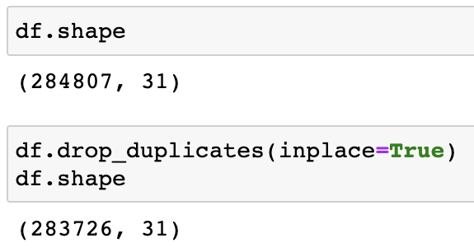

Data Preprocessing
We can see that our dataset originally had 284807 rows, but after deleting duplicates, it is down to 283726, which allows our model to process and run faster.

Slide 6
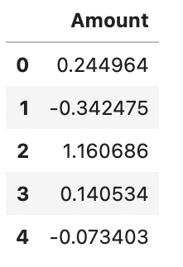

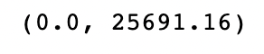
Data Scaling
We're attempting to determine whether our data needs to be scaled by determining the minimum and maximum amount, and as we can see, there's a significant difference between the two, therefore we've scaled the data.

Slide 7
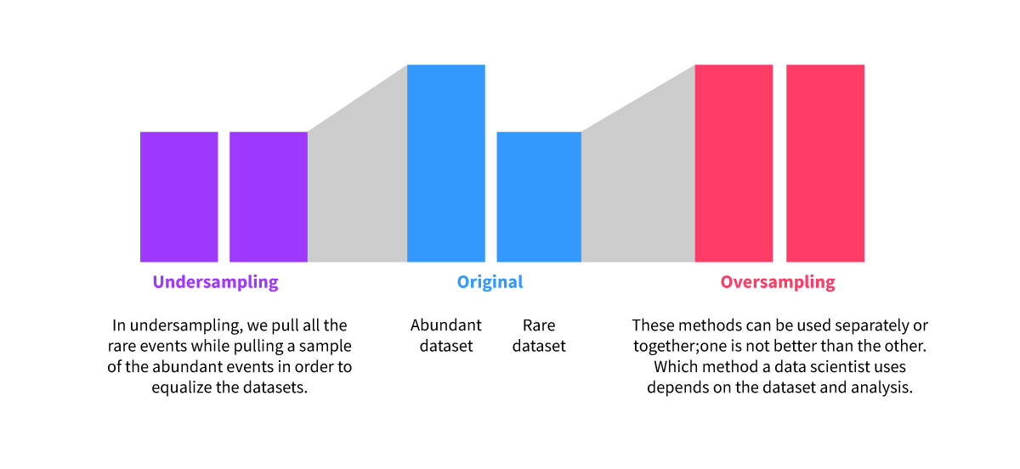
Types of Sampling
OVER SAMPLING
UNDER SAMPLING
CLASS WEIGHT
Difference between Over Sampling And Under Sampling

Slide 8
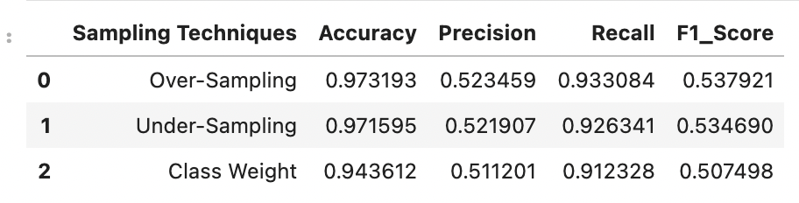

Over sampling/Under sampling/Class Weight
After analyzing all the values, we determined that over sampled data had the best Accuracy and F1 score using Logistic Regression model, hence we built our model entirely on over sampled data throughout our project.

Slide 9
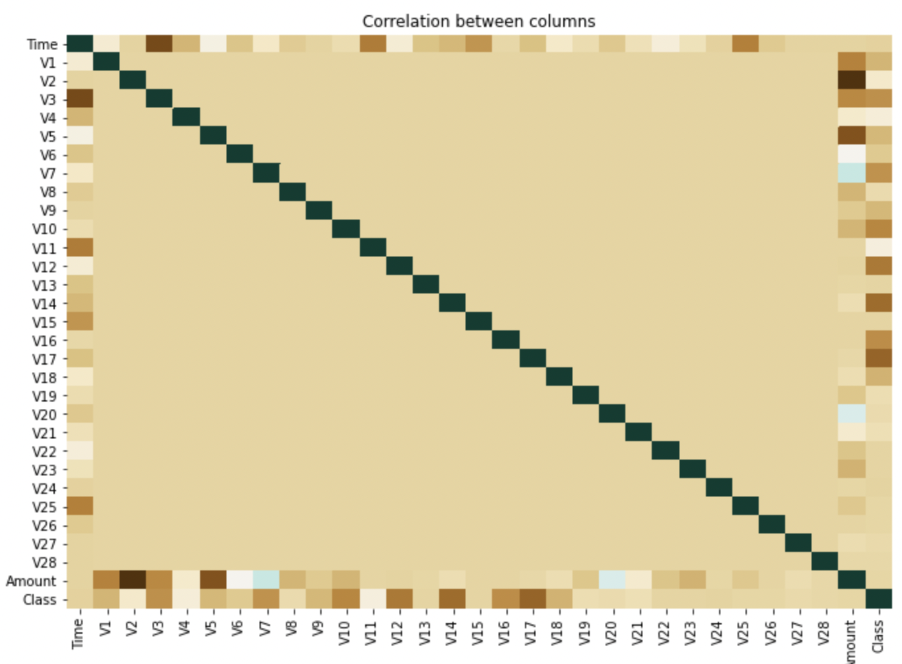
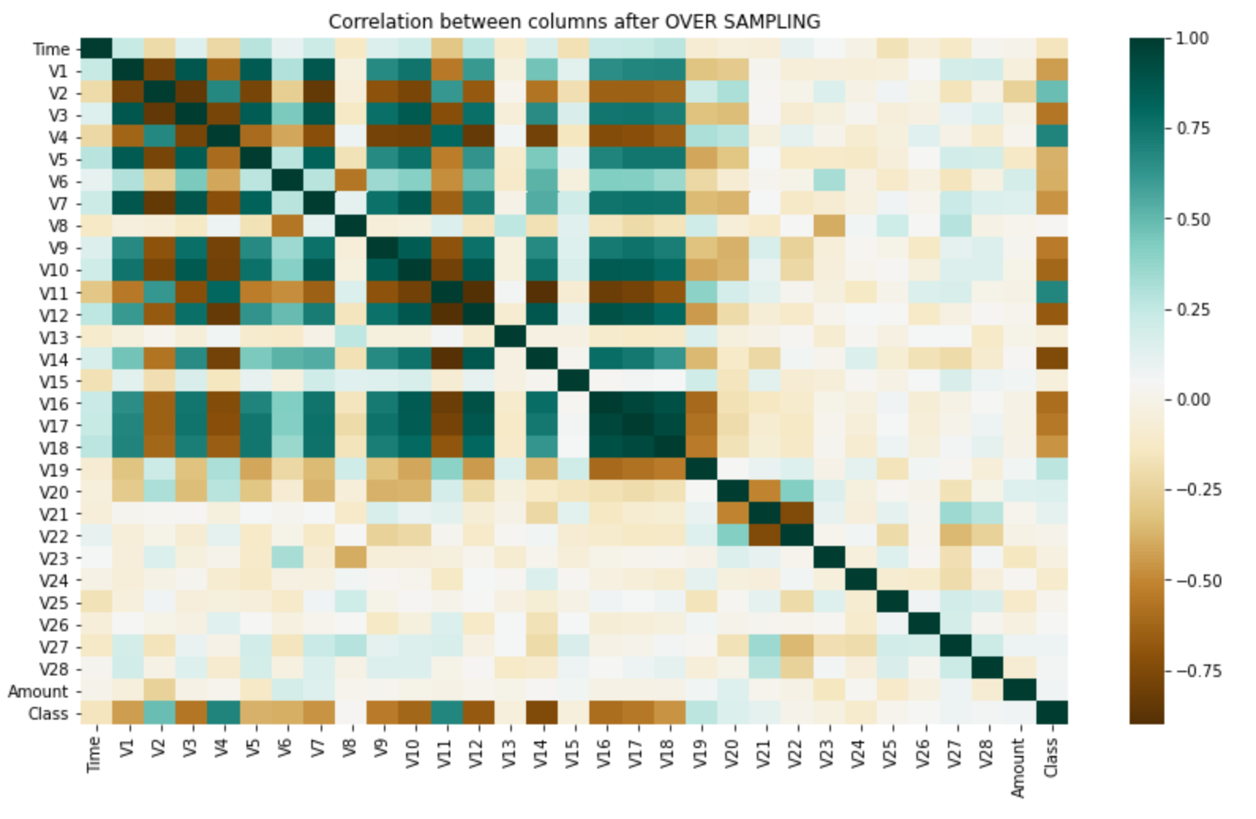
Correlation Plot (Imbalanced Data vs. Oversampled Data)

Slide 10

Model Building
A ML model is developed by learning and generalizing from training data, then applying that knowledge to unknown new data in order to generate predictions and achieve its objective.
Four Supervised Learning Algorithms used for Model Building:
Logistic Regression
Decision Tree
Random Forest
KNN Classifier

Slide 11
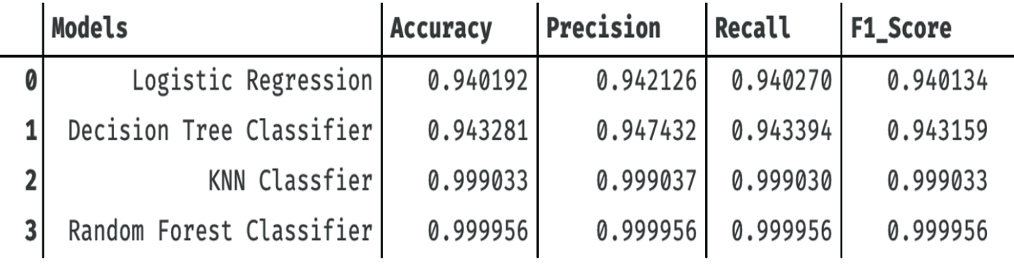
Evaluation Metrics Comparison
After analyzing all the models that we built on our data set, we can confidently propose the Random Forest model, which has the highest Accuracy and F1-score among all of them.

Slide 12
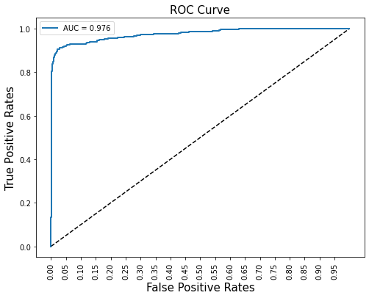
ROC Curve
ROC Curve for Random Forest model
An ROC curve (Receiver Operating Characteristic curve) is a graph showing the performance of a classification model at all classification thresholds.
This curve plots two parameters:
True Positive Rate
False Positive Rate
We may anticipate that our model will perform better on unseen data because our AUC value is approaching 1.

Slide 13
Why Random Forest?
Two important factors make the Random Forest algorithm for preventing fraud effective at making predictions:
The first is randomness, which means that rows and columns of data from the dataset are picked at random and fitted into multiple Decision Trees.
The second component is heterogeneity, which means that instead of just one decision tree, there are a forest of trees that lead to the conclusion. The key benefit is that this diversity reduces the likelihood of model overfitting while maintaining the bias.

Slide 14
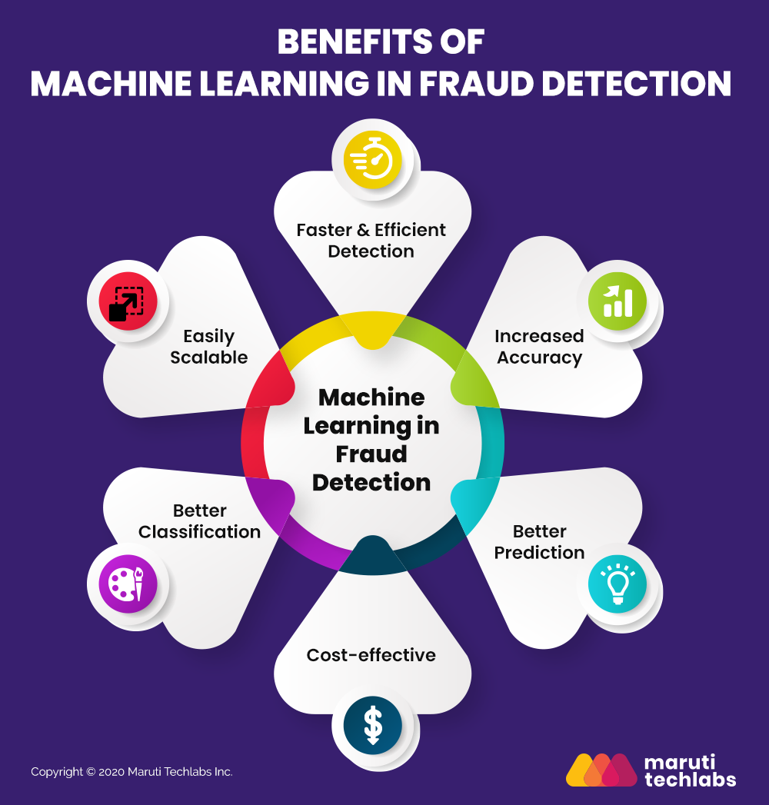
Insights & Impact
The model you use should be able to quickly recognize these frequent system irregularities.
If a single account adds various payment methods in less than an hour, this is a red flag that the account may be fraudulent.
The profile's location or address is fake; that is, it does not exist.
There is a mismatch between the account name and the card name.

Slide 15

Conclusion
To detect fraud, various machine learning models can be utilized, each with its own set of advantages and disadvantages.
Some models are difficult to understand, explain, and debug but have high accuracy (e.g., Neural Networks); others are simpler and can be interpreted and depicted as a set of rules (e.g., Decision Trees).
It's critical to keep training the Fraud Detection model as fresh information comes in so that new fraud patterns may be learned, and fraudulent data can be caught as soon as feasible.

Slide 16
References
https://www.kaggle.com/datasets/mlg-ulb/creditcardfraud
https://marutitech.com/machine-learning-fraud-detection/
https://journalofbigdata.springeropen.com/articles/10.1186/s40537-022-00573-8

Slide 17


ANY QUESTIONS

Slide 18

THANK YOU

